Slide 1
ALGORITHM DESIGN
AND ANALYSIS
PROJECT 1
Wong Chu Feng & Rivaldo Billy Sebastian

Slide 2

PROBLEM STATEMENT
In Mergesort, when the sizes of subarrays are small, the overhead of many recursive calls makes the algorithm inefficient. Therefore, in real use, we often combine Mergesort with Insertion Sort to come up with a hybrid sorting algorithm for better efficiency. The idea is to set a small integer S as a threshold for the size of subarrays. Once the size of a subarray in a recursive call of Mergesort is less than or equal to S, the algorithm will switch to Insertion Sort, which is efficient for small-sized input.

Slide 3
(a) Algorithm Implementation
Implement the above algorithm.
Our approach is going as follows:
Define Insertion Sort
Define Merge, then MergeSort
Define Hybrid Sort
Combine Insertion Sort and MergeSort

Slide 4
Define Insertion Sort
def insertionSort(n, m):
for i in range(n+1, m):
for j in range(i, n, -1):
if L[j] < L[j-1]: L[j], L[j-1] = L[j-1], L[j]
else: break

Slide 5
2. Define Merge
def merge(n, m):
if m-n <= 0: return L
mid = n + (m-n)//2
a, b = n, mid+1
while a <= mid and b <= m:
if L[a] < L[b]:
a += 1
elif L[a] > L[b]:
temp = L[b]
for i in range(b, a, -1):
L[i] = L[i-1]
L[a] = temp
a += 1
b += 1
mid += 1
else: # L[a] == L[b]
if a == mid and b == m: break
a += 1
temp = L[b]
for i in range(b, a, -1):
L[i] = L[i-1]
L[a] = temp
a += 1
b += 1
mid += 1

Slide 6
2. Define MergeSort
def mergeSort(n, m):
mid = (m-n)//2
if m-n <= 0: return
else: # m-n >= 1
mergeSort(n, mid)
mergeSort(mid+1, m)
merge(n, m)

Slide 7
3. Define Hybrid Sort
Combine Insertion Sort and MergeSort
def mergeSort(n, m):
mid = (m-n)//2
if m-n <= 0: return
else: # m-n >= 1
mergeSort(n, mid)
mergeSort(mid+1, m)
merge(n, m)

Slide 8
(b) Generate Input Data
Generate arrays of increasing sizes, in a range from 1,000 to 10 million. For each of the sizes, generate a random dataset of integers in the range of [1, …, x], where x is the largest number you allow for your datasets.
import random
def generate(N): #create arrays of varying sizes and random int values
L_arr = random.sample(range(1,10**5), N)
return L_arr

Slide 9
(c) Analyze Time Complexity
Run your program of the hybrid algorithm on the datasets generated in Step (b). Record the number of key comparisons performed in each case.
We redefine the function merge and mergeSort, as well as insertionSort and switchSort to add counter key_comparison.

Slide 10
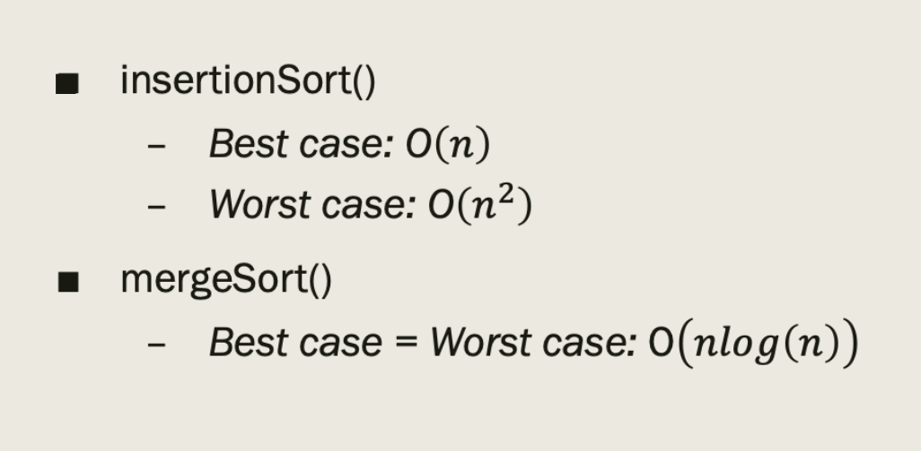
Theoretical analysis (original algorithms)

Slide 11
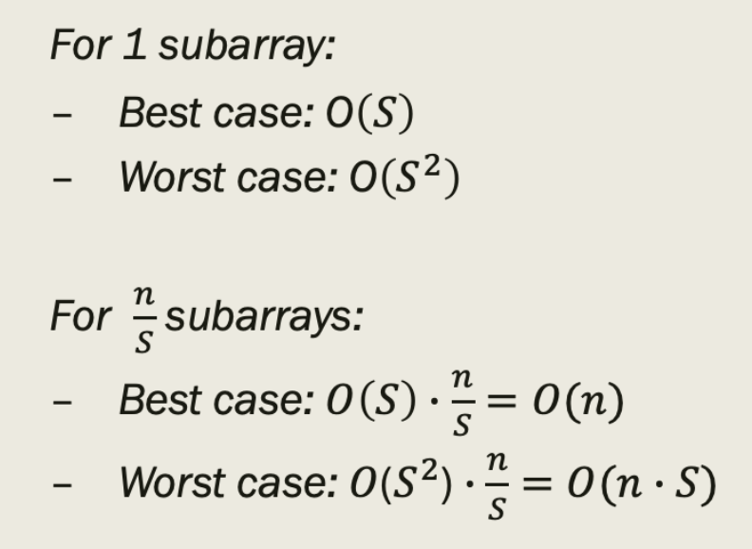
Theoretical analysis (insertionSort algorithm)
Considering subarrays of size S,

Slide 12
(c) Analyze Time Complexity
Next, we work for varying n from 1 to 100,000 and S from 1 to 45.
M = np.zeros((45,100)) # 2D array stores KEYCOMP_TOTAL
st = time.process_time()
for S in range(1,45):
for n in range(1,10**5):
L=generate(n)
if (n<=S): #if n<=S, use n
M[S][n]=switchSort(0,n-1,n)
else:
M[S][n] = switchSort(0,n-1,S)
et = time.process_time()
divnorm = colors.TwoSlopeNorm(vcenter=0.)
ax = sns.heatmap(M, linewidths=0, cmap='seismic', norm=divnorm)
plt.xlabel("Array size, n")
plt.ylabel("Threshold, S")
plt.show()
print("CPU time: ",et-st)

Slide 13
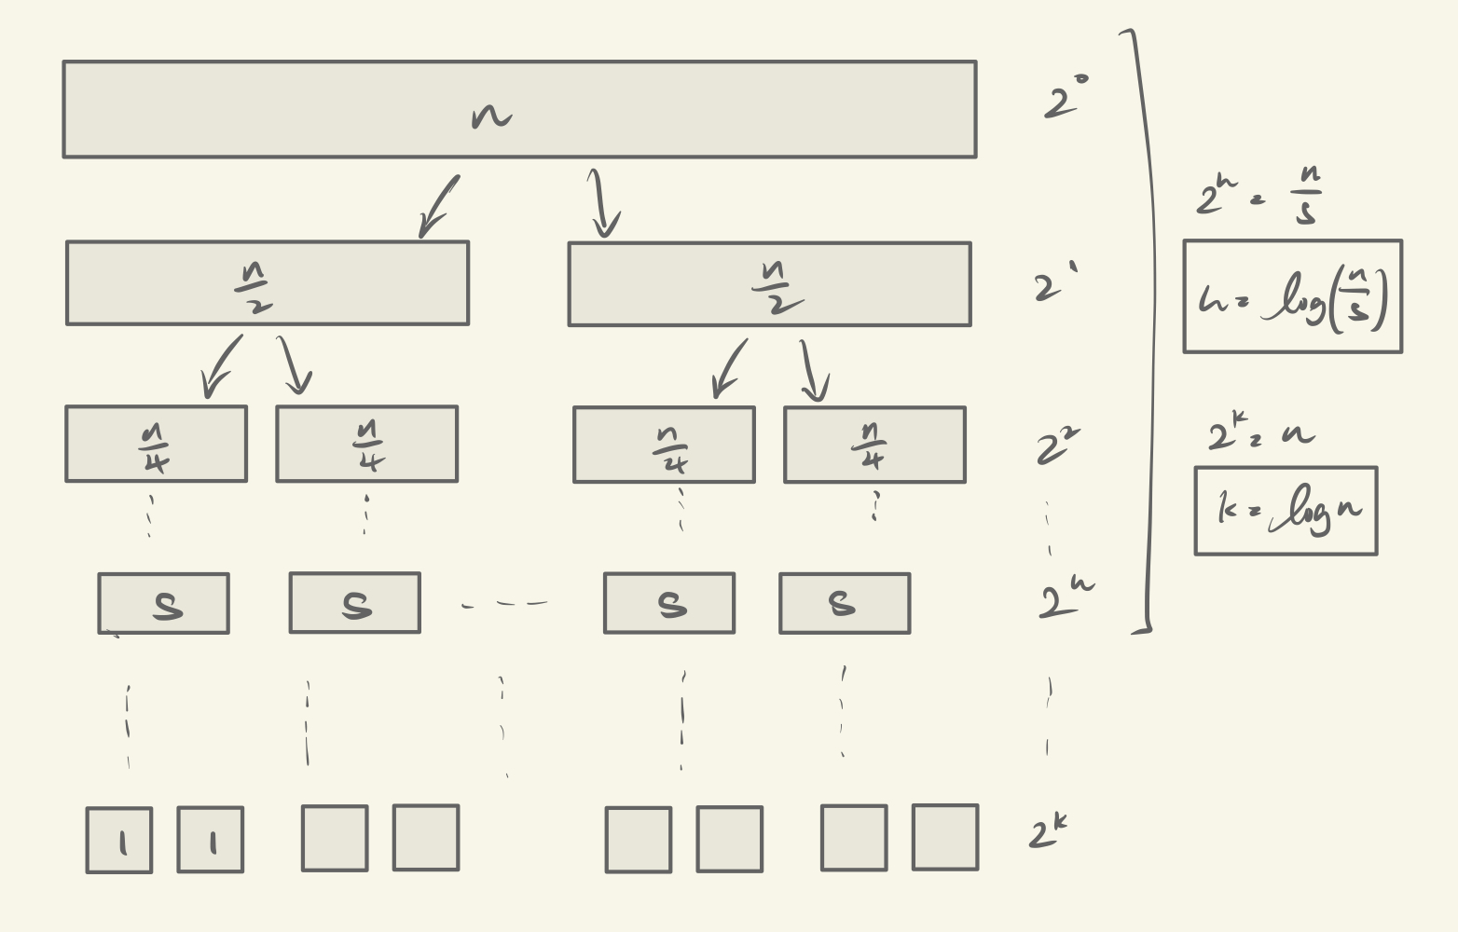
Theoretical analysis (hybrid algorithm)

Slide 14
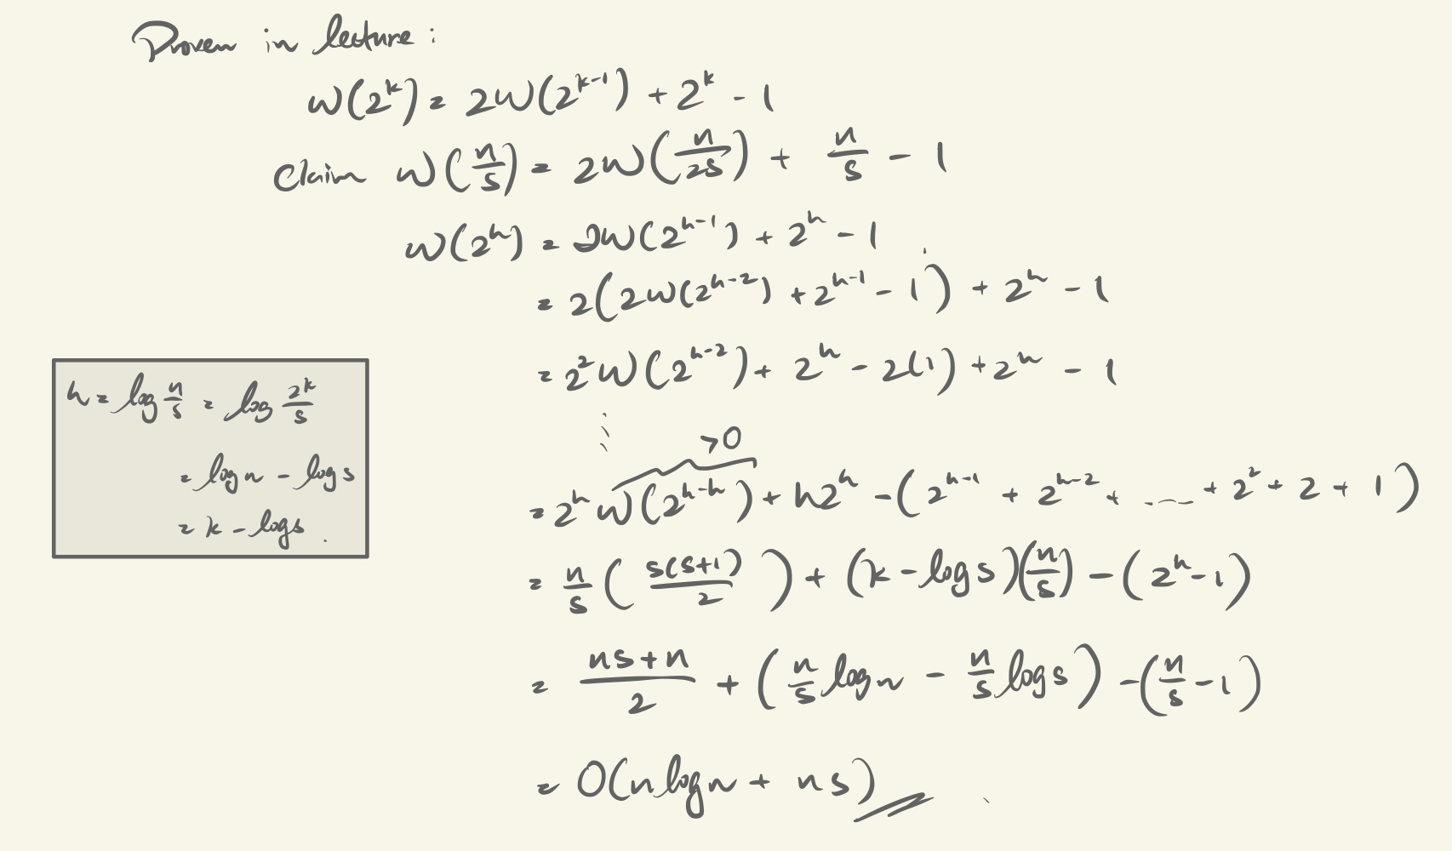
Theoretical analysis (hybrid algorithm)

Slide 15
Redefine Insertion Sort
def insertionSort(n, m):
key_comparison = 0
for i in range(n+1, m):
for j in range(i, n, -1):
key_comparison += 1
if L[j] < L[j-1]:
L[j], L[j-1] = L[j-1], L[j]
else: break
return key_comparison

Slide 16
2. Redefine Merge
def merge(n, m):
key_comparison = 0
if m-n <= 0: return 0
mid = n + (m-n)//2
a, b = n, mid+1
while a <= mid and b <= m:
key_comparison += 1
if L[a] < L[b]:
a += 1
elif L[a] > L[b]:
temp = L[b]
for i in range(b, a, -1):
L[i] = L[i-1]
L[a] = temp
a += 1
b += 1
mid += 1
else: # L[a] == L[b]
if a == mid and b == m: break
a += 1
temp = L[b]
for i in range(b, a, -1):
L[i] = L[i-1]
L[a] = temp
a += 1
b += 1
mid += 1
return key_comparison

Slide 17
2. Redefine MergeSort
def mergeSort(n, m):
mid = (m-n)//2
if m-n <= 0: return 0
else: # m-n >= 1
key_comparison_l = mergeSort(n, mid)
key_comparison_r = mergeSort(mid+1, m)
key_comparison_merge = merge(n, m)
return key_comparison_l + key_comparison_r + key_comparison_merge

Slide 18
3. Define Hybrid Sort
Combine Insertion Sort and MergeSort
def switchSort(n, m, S):
key_comparision = 0
if m-n > S: key_comparison = mergeSort(n, m, S)
else: key_comparison = insertionSort(n, m)
return key_comparison

Slide 19
i. With the value of S fixed, plot the number of key comparisons over different sizes of the input list n. Compare your empirical results with your theoretical analysis of the time complexity.
We fix S = 20, and vary over values n from 1 to 100,000
vary_n = []
for i in range(0,10**5):
vary_n.append(M[19][i])
plt.scatter(np.arange(0,10**5), vary_n, c='blue')
plt.xlabel("Array size, n")
plt.ylabel("no, of key comparisons")
plt.title("fix S=20, vary n")
plt.show()

Slide 20
ii. With the input size n fixed, plot the number of key comparisons over different values of S . Compare your empirical results with your theoretical analysis of the time complexity.
We fix S = 20, and vary over values n from 1 to 100,000
vary_S=[]
for i in range(1,45):
vary_S.append(M[i][10**5])
plt.scatter(np.arange(1, 45), vary_S, c='blue')
plt.xlabel("Threshold, S")
plt.ylabel("no, of key comparisons")
plt.title("vary S, fix n=10**5")
plt.show()

Slide 21
iii. Using different sizes of input datasets, study how to determine an optimal value of S for the best performance of this hybrid algorithm.
We calculate the key_comparison count of using mergeSort() and switchSort(), and compare them over different values of n.
M_f = np.subtract(M,M2)
divnorm = colors.TwoSlopeNorm(vcenter=0.)
ax2 = sns.heatmap(M_f, linewidths=0, cmap='seismic', norm=divnorm)
plt.xlabel("Array size, n")
plt.ylabel("Threshold, S")
plt.show()

Slide 22
Obtaining Optimal S Value

Slide 23
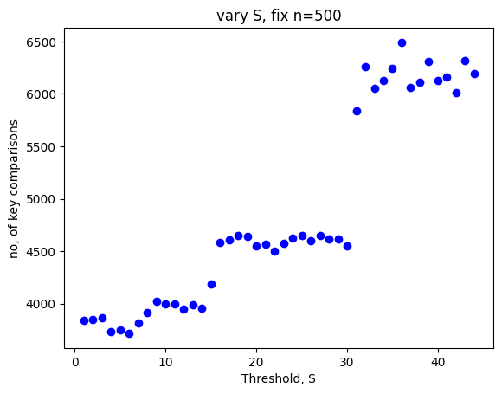
Comparing with no. of
key comparisons
Worst case
At S=16:
there is a sharp increase increase in key comparisons
Best case

Slide 24
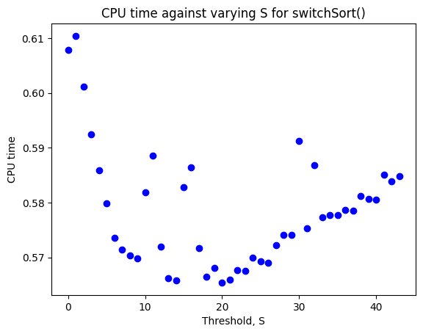
Comparing with CPU time
At S=19,
-CPU time is the lowest

Slide 25
Optimal S value
Using key comparisons, choose S = [9, 16]
Using CPU time, we choose S=19
Hence safely choose S = [9, 19]

Slide 26
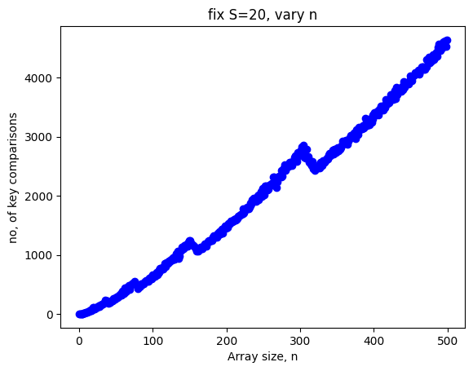
Varying size of array, n
At S=20
Worst case
Best case

Slide 27
(d) Compare with original Mergesort
Implement the original version of Mergesort as learnt in lecture. Compare its performance against the above hybrid algorithm in terms of the number of key comparisons and CPU times on the dataset with 10 million integers. You can use the optimal value of S obtained in (c) for this task.

Slide 28
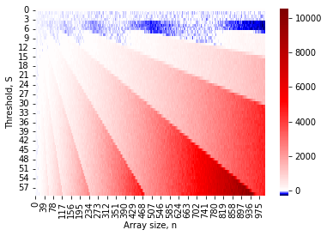
Comparing hybrid algo & mergeSort
key_comp (hybrid) - key_comp (mergeSort)
Notes:
From here, we can determine the optimal value of S.
Aim: make switchSort() an improved version of mergeSort() after incoporating insertionSort() for smaller arrays
Graph: numpy.subtract(switchSort(), mergeSort())
Positive regions(red) would mean the former has more key comparisons than the original algorithm and is undesirable.
Value of S in (white) regions would mean switchSort() has roughly the same number of comparisons as mergeSort() and (blue) regions switchSort() is more effective.
=> Therefore, range of values of S should be between the (blue) and (white) regions.

Slide 29
Summary
no. of key comparisons is not proportional to CPU time
-> recursive overhead
Trade-offs have to be made, choosing no.of key comparisons or CPU time

Slide 30
Some Notes
Python Language on Google Colab
Libraries Used:
from matplotlib import colors
import seaborn as sns
import matplotlib.pyplot as plt
import numpy as np
import math
import time

